Slide 1




G.H. RAISONI COLLEGE OF ENGINEERING
AND MANAGEMENT, WAGHOLI, PUNE.
Department of AI & AIML
Presentation on
Steganography Techniques for Digital Images
By:
1.Aman Maher (B 58) 2. Rohan Ingle (B 61)
3.Nachiket Parjane (B62) 4. Kartik Patare (B 69)
Under The Guidance of
Prof:Yogesh Mali Sir

Slide 2
Contents
Introduction
Project Goals
Problem Statement
Problem Statement
Hardware Requirement
Software Requirement
Module Used
Data flow
Conclusion
Literature Review
References

Slide 3
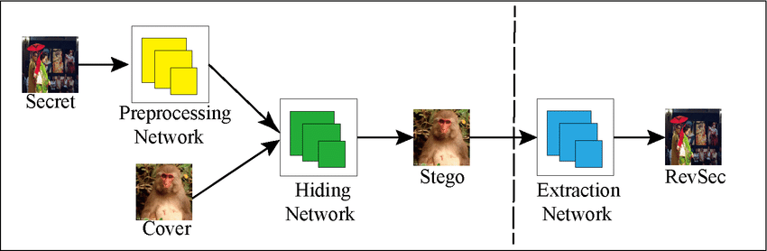
Introduction
Image steganography is a technique used to hide information, messages, or data within digital images in such a way that the presence of the hidden information is not apparent to casual observers.
This is done by subtly altering the pixel values or properties of the image in a manner that doesn't significantly affect the visual quality of the image to the human eye. The primary goal of image steganography is to conceal the fact that any hidden information exists within the image.

Slide 4
Project Goals
Hiding data, including encoding the data to prepare it to be hidden inside another file
Keeping track of which bits of the cover text file contain hidden data.
Encode and Decoding the data to be hidden.
Extracting hidden data by its intended recipient.

Slide 5
Problem Statement
Image steganography is an essential technique for secure communication, data protection, and authentication in various fields. It involves hiding sensitive information within digital images while maintaining the visual integrity of the images. The project aims to develop a Python-based image steganography application that enables users to embed and extract hidden data from images securely and efficiently.

Slide 6
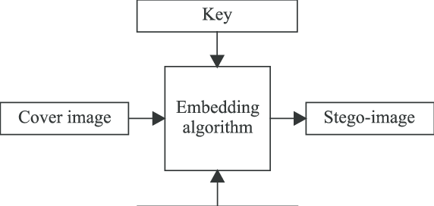
Data Flow
LSB

Slide 7
Module Used
tkinter: is a standard Python library for creating graphical user interfaces (GUIs)
PIL:- . It provides a wide range of image processing and manipulation capabilities.

Slide 8
Software And Hardware Required
Hardware Requirements
Ram 4GB
Processor 2 core
Software requirements
Python(above 3.5)
Code Eidditor: Visual Studio Code
Operating System : windows \ linux

Slide 9
Conclusion
Steganography is the technique of hiding data within an ordinary, nonsecret file or message to avoid detection; the hidden data is then extracted at its destination. Steganography use can be combined with encryption as an extra step for hiding or protecting data. The word steganography is derived from the Greek word steganos, meaning "hidden or covered," and the Greek root graph, meaning "to write."
The practice of adding a watermark -- a trademark or other identifying data hidden in multimedia or other content files -- is a common use of steganography. Online publishers often use watermarking to identify the source of media files that are being shared without permission.

Slide 10
Literature Review
Steganography Techniques for Digital Images Authors: Abid Yahya Applies and discusses innovative techniques for hiding text in a digital image file or even using it as a key to the encryption
Information Hiding Techniques for Cryptography and Steganography Bhawna, Sanjay Kumar & Vijendra Singh

Slide 11
Reference
https://matlabprojects.org/steganography-projects/
https://data-flair.training/blogs/python-image-steganography-project/
https://programmer2programmer.net/live_projects/project_7/steganography.aspx
https://academiccollegeprojects.com/steganography-projects/

Slide 12
Thank you !

